Slide 1

Faculty of Applied Engineering and Urban Planning
Civil Engineering Department
Dr. Eng. Mustafa Maher Al-tayeb
2 Semester 2022/2023
Probabilistic and Statistical

Slide 2
Probabilistic and Statistical Techniques
Chapter 2
Summarizing and Graphing Data

Slide 3
Probabilistic and Statistical Techniques
2-1 Overview
2-2 Frequency Distributions
2-3 Histograms
2-4 Statistical Graphics

Slide 4
Probabilistic and Statistical Techniques
Overview
Important Characteristics of Data
1. Center: A representative or average value that indicates where the middle of the data set is located.
2. Variation: A measure of the amount that the values vary among themselves.
3. Distribution: The nature or shape of the distribution of data (such as bell-shaped, uniform, or skewed).
4. Outliers: Sample values that lie very far away from the vast majority of other sample values.

Slide 5
Probabilistic and Statistical Techniques
Frequency Distributions

Slide 6
Probabilistic and Statistical Techniques
Key Concept
When working with large data sets, it is often helpful to organize and summarize data by constructing a table called a frequency distribution, defined later.
Because computer software and calculators can generate frequency distributions, the details of constructing them are not as important as what they tell us about data sets.

Slide 7
Probabilistic and Statistical Techniques
Definition
Frequency Distribution (or Frequency Table)
lists data values (either individually or by groups of intervals), along with their corresponding frequencies or counts

Slide 8
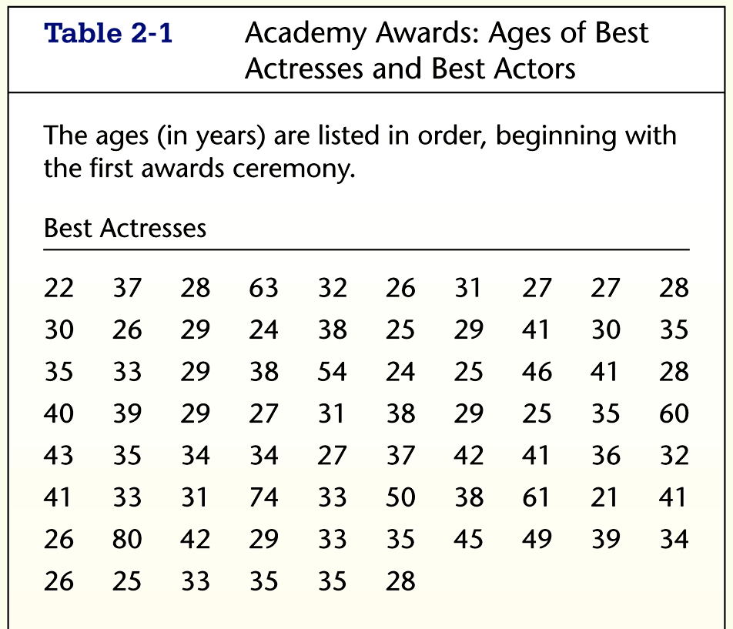
Probabilistic and Statistical Techniques
Frequency Distribution Ages of Best Actresses
Original Data

Slide 9
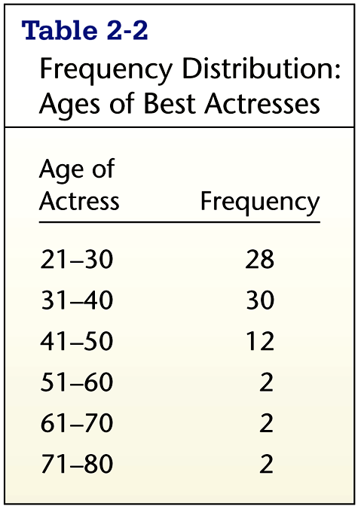
Probabilistic and Statistical Techniques
Frequency Distribution Ages of Best Actresses
Frequency Distribution

Slide 10
Probabilistic and Statistical Techniques
Lower Class Limits
are the smallest numbers that can actually belong to different classes
Lower Class
Limits

Slide 11
Probabilistic and Statistical Techniques
Upper Class Limits
are the largest numbers that can actually belong to different classes
Upper Class
Limits

Slide 12
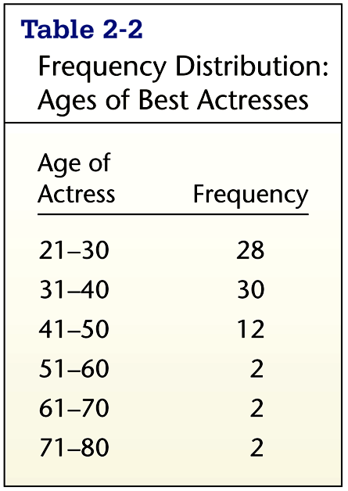
Probabilistic and Statistical Techniques
Class Boundaries
are the numbers used to separate classes, but without the gaps created by class limits
Editor: Substitute Table 2-2
20.5
30.5
40.5
50.5
60.5
70.5
80.5
Class
Boundaries

Slide 13
Probabilistic and Statistical Techniques
Class Midpoints
can be found by adding the lower class limit to the upper class limit and dividing the sum by two
25.5
35.5
45.5
55.5
65.5
75.5
Class
Midpoints

Slide 14
Probabilistic and Statistical Techniques
Class Width
is the difference between two consecutive lower class limits or two consecutive class boundaries
Editor: Substitute Table 2-2
10
10
10
10
10
10
Class
Width

Slide 15
Probabilistic and Statistical Techniques
Reasons for Constructing
Frequency Distributions
1. Large data sets can be summarized.
2. We can gain some insight into the nature of data.
3. We have a basis for constructing important graphs such as Histogram.

Slide 16
Probabilistic and Statistical Techniques
Constructing A Frequency Distribution
1. Decide on the number of classes (should be between 5 and 20).
2. Calculate class width
class width ≈
(maximum value) – (minimum value)
number of classes
3. Starting point: Begin by choosing a lower limit of the first class.
Using the lower limit of the first class and class width, proceed to list the lower class limits.
5. List the lower class limits in a vertical column and proceed to enter the upper class limits.
6. Go through the data set putting each data value in its class interval

Slide 17
Probabilistic and Statistical Techniques
Constructing A Frequency Distribution
1. Decide on the number of classes (should be between 5 and 20).
A useful recipe to determine the number of classes (K) is the “2 to the k rule”. This guide suggests you select the smallest number k for the number of classes such that 2^{k} is greater than the number of observations n.

Slide 18
Probabilistic and Statistical Techniques
Relative Frequency Distribution
includes the same class limits as a frequency distribution, but relative frequencies are used instead of actual frequencies
class frequency
Relative Frequency =
sum of all frequencies

Slide 19
Probabilistic and Statistical Techniques
Relative Frequency Distribution
Total Frequency = 76

Slide 20
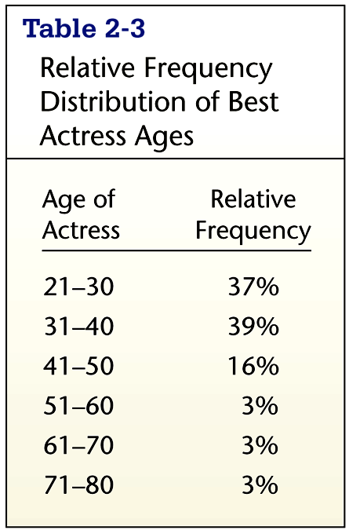
Probabilistic and Statistical Techniques
Relative Frequency Distribution
28/76 = 37%
30/76 = 39%
etc.

Slide 21
Probabilistic and Statistical Techniques
Cumulative Frequency Distribution

Slide 22
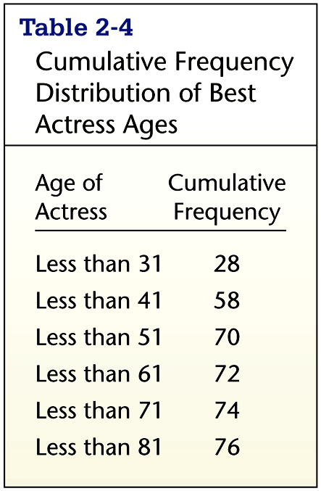
Probabilistic and Statistical Techniques
Cumulative Frequency Distribution
Cumulative
Frequencies

Slide 23
Probabilistic and Statistical Techniques
Frequency Tables

Slide 24
Probabilistic and Statistical Techniques
Critical Thinking Interpreting Frequency Distributions
In later chapters, there will be frequent reference to data with a normal distribution. One key characteristic of a normal distribution is that it has a “bell” shape.
The frequencies start low, then increase to some maximum frequency, then decrease to a low frequency.
The distribution should be approximately symmetric.

Slide 25
Probabilistic and Statistical Techniques
Histograms

Slide 26
Probabilistic and Statistical Techniques
Key Concept
A histogram is an important type of graph that portrays the nature of the distribution.

Slide 27
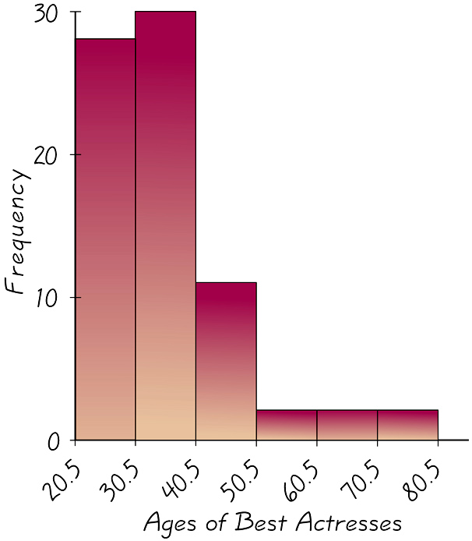
Probabilistic and Statistical Techniques
Histogram
A bar graph in which the horizontal scale represents the classes of data values and the vertical scale represents the frequencies

Slide 28
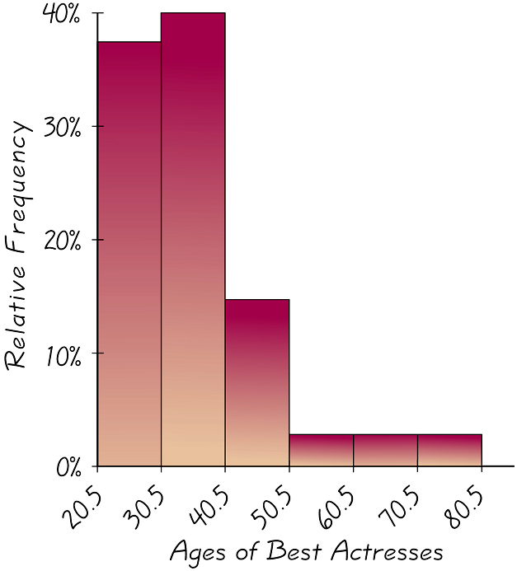
Probabilistic and Statistical Techniques
Relative Frequency Histogram
Has the same shape and horizontal scale as a histogram, but the vertical scale is marked with relative frequencies instead of actual frequencies

Slide 29
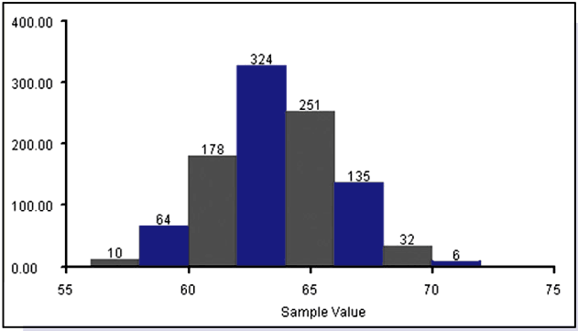
Probabilistic and Statistical Techniques
Critical Thinking
One key characteristic of a normal distribution is that it has a “bell” shape. The histogram below illustrates this.

Slide 30
Probabilistic and Statistical Techniques
Statistical Graphics

Slide 31
Probabilistic and Statistical Techniques
Key Concept
This section presents other graphs beyond histograms commonly used in statistical analysis.
The main objective is to understand a data set by using a suitable graph that is effective in revealing some important characteristic.

Slide 32
Probabilistic and Statistical Techniques
Tabular and Graphical Procedures
Data
Qualitative Data
Quantitative Data
Tabular
Methods
Graphical
Methods
Tabular
Methods
Graphical
Methods
Frequency
Distribution
Rel. Freq. Dist.
Percent Freq.
Distribution
Bar Graph
Pie Chart
Dot Plot
Histogram
Ogive
Scatter
Diagram
Frequency
Polygon
Frequency
Distribution
Rel. Freq. Dist.
Cum. Freq. Dist.
Cum. Rel. Freq.
Distribution
Stem-and-Leaf
Display

Slide 33
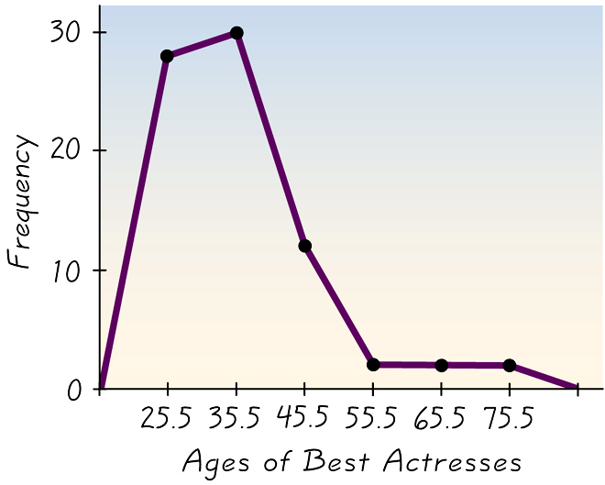
Probabilistic and Statistical Techniques
Frequency Polygon
Uses line segments connected to points directly above class midpoint values

Slide 34
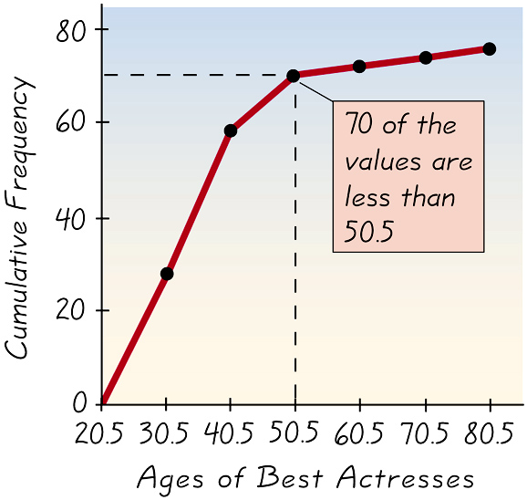
Probabilistic and Statistical Techniques
Ogive (S – Curve)
A line graph that depicts cumulative frequencies

Slide 35
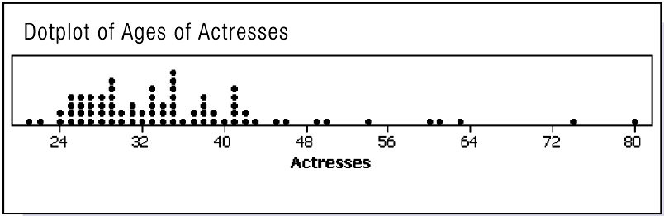
Probabilistic and Statistical Techniques
Dot Plot
Consists of a graph in which each data value is plotted as a point (or dot) along a scale of values

Slide 36
Probabilistic and Statistical Techniques
Probabilistic and Statistical Techniques
Bar Graph
A bar graph is a graphical device for depicting qualitative data.
On one axis (usually the horizontal axis), we specify
the labels that are used for each of the classes.
A frequency, relative frequency, or percent frequency
scale can be used for the other axis (usually the vertical axis).
Using a bar of fixed width drawn above each class
label, we extend the height appropriately.
The bars are separated to emphasize the fact that each
class is a separate category.

Slide 37
Probabilistic and Statistical Techniques
Bar Graph
10
9
8
7
6
Frequency
5
4
3
2
1
Poor
Below
Average
Average
Above
Average
Excellent

Slide 38
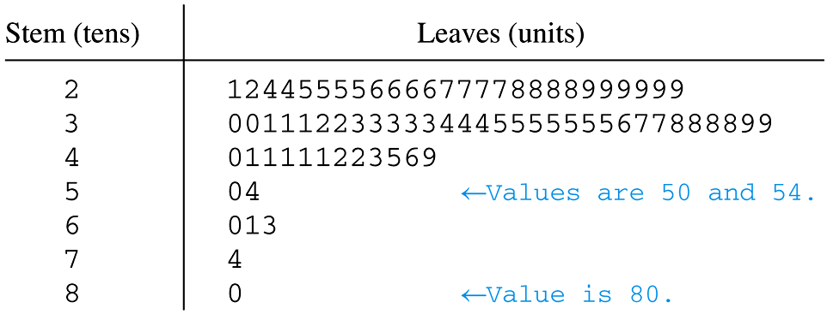
Probabilistic and Statistical Techniques
Stemplot (or Stem-and-Leaf Plot)
Represents data by separating each value into two parts: the stem (such as the leftmost digit) and the leaf (such as the rightmost digit)

Slide 39
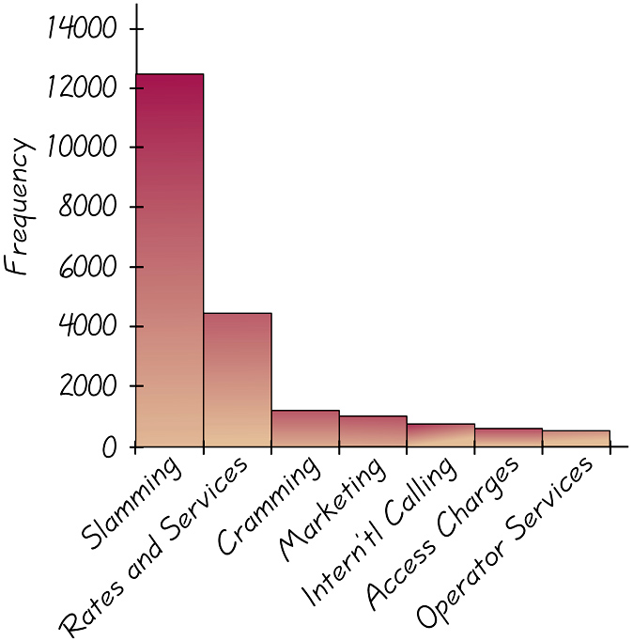
Probabilistic and Statistical Techniques
Pareto Chart
A bar graph for qualitative data, with the bars arranged in order according to frequencies

Slide 40
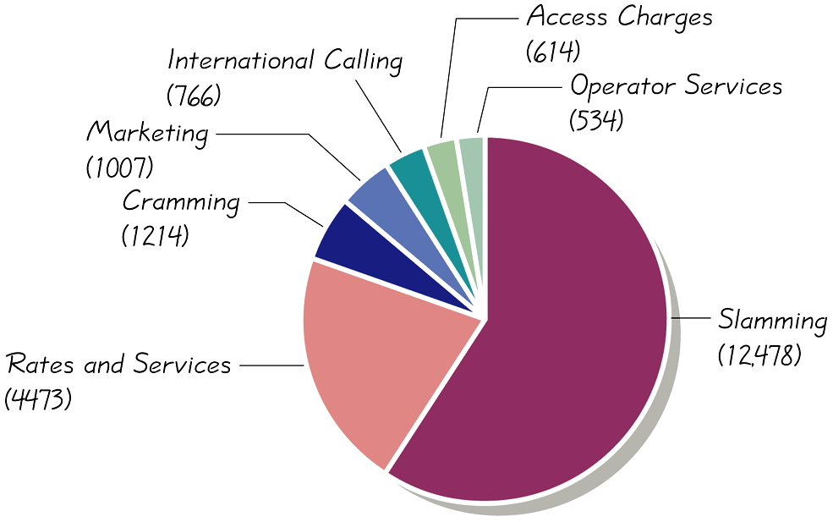
Probabilistic and Statistical Techniques
Pie Chart
A graph depicting qualitative data as slices of a pie

Slide 41
Probabilistic and Statistical Techniques
Pie Chart
The pie chart is a commonly used graphical device
for presenting relative frequency distributions for
qualitative data.
First draw a circle; then use the relative
frequencies to subdivide the circle
into sectors that correspond to the
relative frequency for each class.
Since there are 360 degrees in a circle,
a class with a relative frequency of .25 would
consume .25(360) = 90 degrees of the circle.

Slide 42
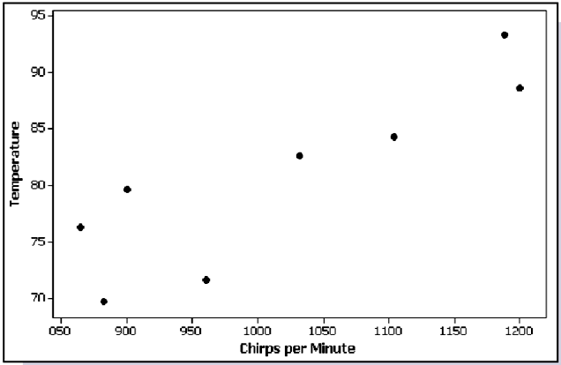
Probabilistic and Statistical Techniques
Scatter Plot (or Scatter Diagram)
A plot of paired (x,y) data with a horizontal x-axis and a vertical y-axis

Slide 43

Probabilistic and Statistical Techniques

